Slide 1
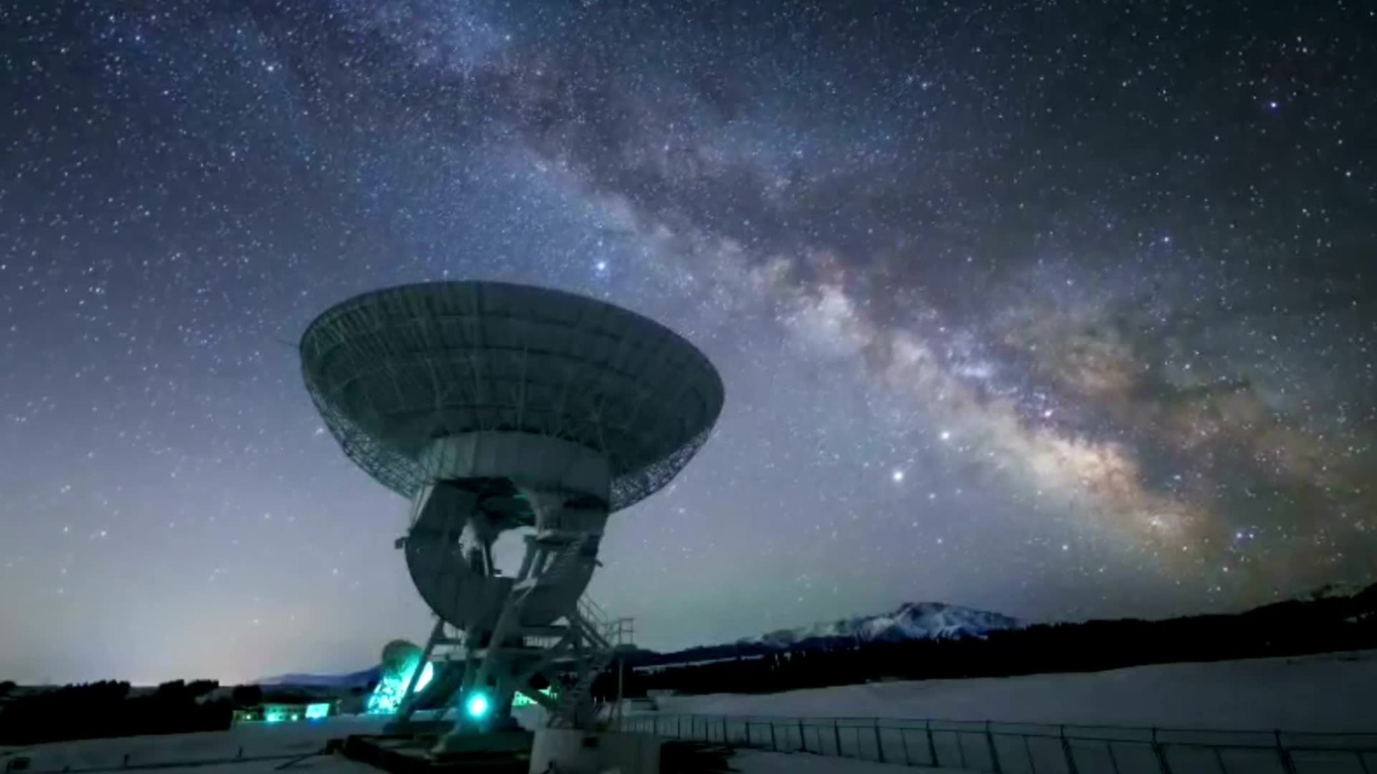
NASA SPACE RESEARCH HUB
Team Name: KosmOS1
Team Members:
Antoinette Wangari
Anne Omollo
Saruni Maina

Slide 2

The Problem: The Knowledge is There, But Hidden
A common saying goes, ‘If you want to hide something from a human being, place it in a book.
But in our case, critical knowledge is hidden in hundreds of complex research papers , inaccessible to most researchers, students, and mission planners.”

Slide 3

Our Solution
We built a functional web application that leverages AI and knowledge graphs to:
Summarize all 608 bioscience studies
Reveal relationships between experiments, species, and outcomes
Enable interactive exploration of key findings using a chatbot (Titan).

Slide 4
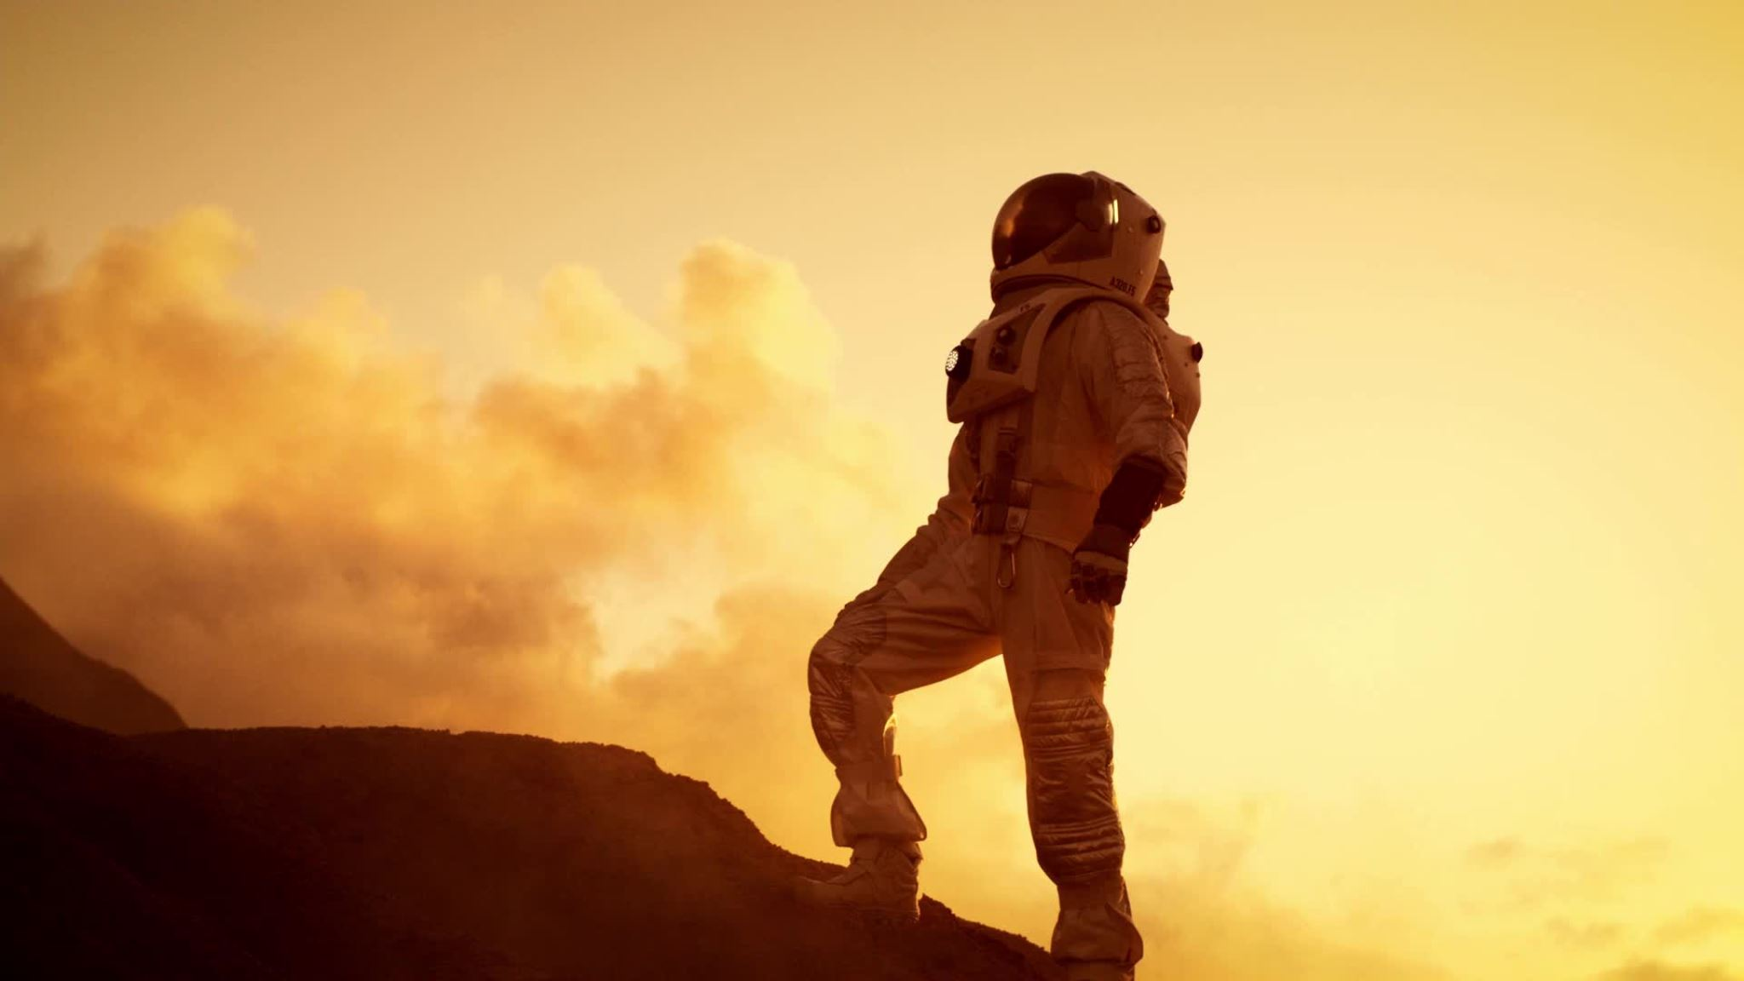
Why It Matters
To sustain human life beyond Earth, we must understand how biology behaves in space.
Every unanswered question could mean a missed opportunity for safer, smarter missions.
Space biology holds keys to solving challenges in medicine, food security, and sustainability on Earth and beyond.

Slide 5


Methodology
Raw Publications
01
Webscraping
02
Database
03
API Endpoints
04
Frontend Components
05
Interactive Dashboard
06
Tools Used:
Frontend
Responsive Web Interface - HTML, CSS, JavaScript
Interactive Visualizations - Chart.js for analytics
3D Chatbot Interface - Model-viewer for immersive experience
Backend & AI Integration
Fast API - Robust API infrastructure
Scrapy + Beautiful soup - Text mining and analysis
Knowledge Graph Engine - Relationship mapping
Intelligent Search - Semantic query processing

Slide 6

Key Features
1. Intelligent Dashboard :Real-time metrics and research insights, AI-generated recommendations and patterns, Critical knowledge gap identification
2. Advanced Search & Exploration: Semantic search across 608 publications. Filter by research areas and timeframes
3. Knowledge Graph Visualization: Interactive network of research concepts, Relationship mapping between studies
4. AI-Powered Analytics: Publication trends and impact analysis, Research methodology insights, Cross-disciplinary correlation discovery

Slide 7

Impact
From hidden data to human discovery.
Empowers researchers to save time and build on existing work.
Helps mission planners identify what’s known and what’s not.
Inspires students and global scientists to participate in space research.
Makes NASA’s knowledge accessible, actionable, and inclusive.
Conclusion
This solution can be used to next generation of Space Biologists.
~ Because Knowledge is for Everyone
~Thank You
~Link to web application:
https://nasa-jy8d.onrender.com/

